Slide 1



Adversarially Robust Submodular Maximization under Knapsack Constraints
DMITRY AVDYUKHIN
SLOBODAN MITROVIĆ
GRIGORY YAROSLAVTSEV
SAMSON ZHOU

Slide 2







Adversarial Robust Submodular Optimization

Slide 3




Adversarial Robust Submodular Optimization

Slide 4
Adversarial Robust Submodular Optimization

Slide 5



Adversarial Robust Submodular Optimization

Slide 6



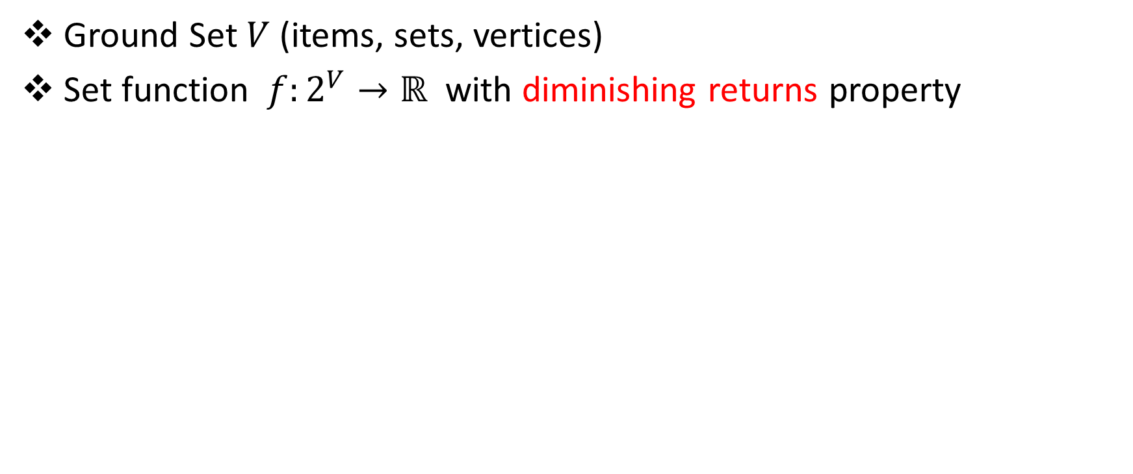

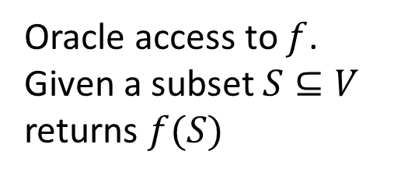

Submodular Functions
Ground Set $V$ (items, sets, vertices)
Set function $f:2^{V}→ℝ$ with diminishing returns property
Oracle access to $f$.
Given a subset $S⊆V$
returns $f(S)$
$$∀ A⊆B⊆V, e∉B$$
$$f\left(A∪\left\{e\right\}\right)−f(A)$$
$$≥$$
$$f\left(B∪\left\{e\right\}\right)−f(B)$$

Slide 7
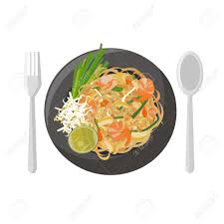

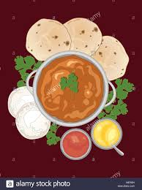

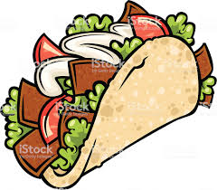





Submodular Functions
$V=$ $\{ \}$
$$A$$
$$B$$
$$f\left(A∪\left\{e\right\}\right)−f(A)$$
$$≥$$
$$f\left(B∪\left\{e\right\}\right)−f(B)$$

Slide 8
Applications of Submodular Functions
Viral marketing [Kempe et al., 2003]
Feature selection [Krause & Guestrin, 2005]
Clustering [Narasimhan & Bilmes, 2005]
Search result diversification [Agrawal et al., 2009]
Recommender systems [El-Arini & Guestrin, 2011]
Active learning [Golovin & Krause, 2011]
Document summarization [Lin & Bilmes, 2011]
Data subset selection [Wei, Iyer & Bilmes, 2015]
etc

Slide 9

Knapsack Constraints
$V=$ $\{ \}$

Slide 10
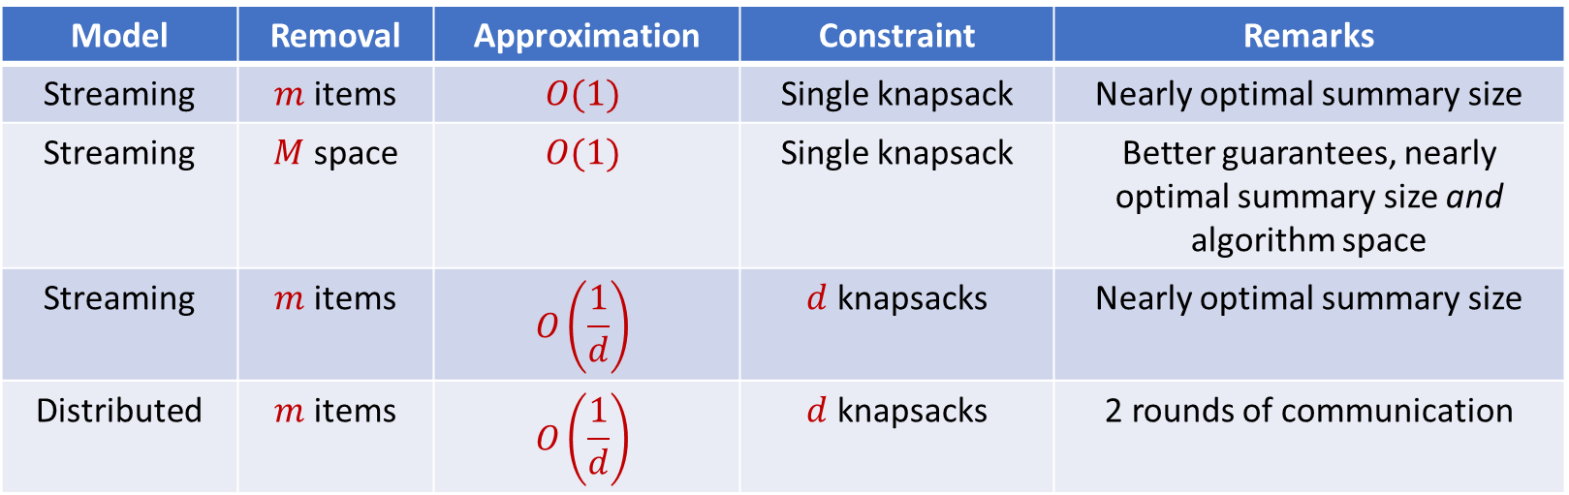
Results
First constant factor approximation algorithms for submodular maximization robust to a number of removals
Model | Removal | Approximation | Constraint | Remarks
Streaming | $m$ items | $$O(1)$$ | Single knapsack | Nearly optimal summary size
Streaming | $M$ space | $$O(1)$$ | Single knapsack | Better guarantees, nearly optimal summary size and algorithm space
Streaming | $m$ items | $$O\left(\frac{1}{d}\right)$$ | $d$ knapsacks | Nearly optimal summary size
Distributed | $m$ items | $$O\left(\frac{1}{d}\right)$$ | $d$ knapsacks | 2 rounds of communication

Slide 11
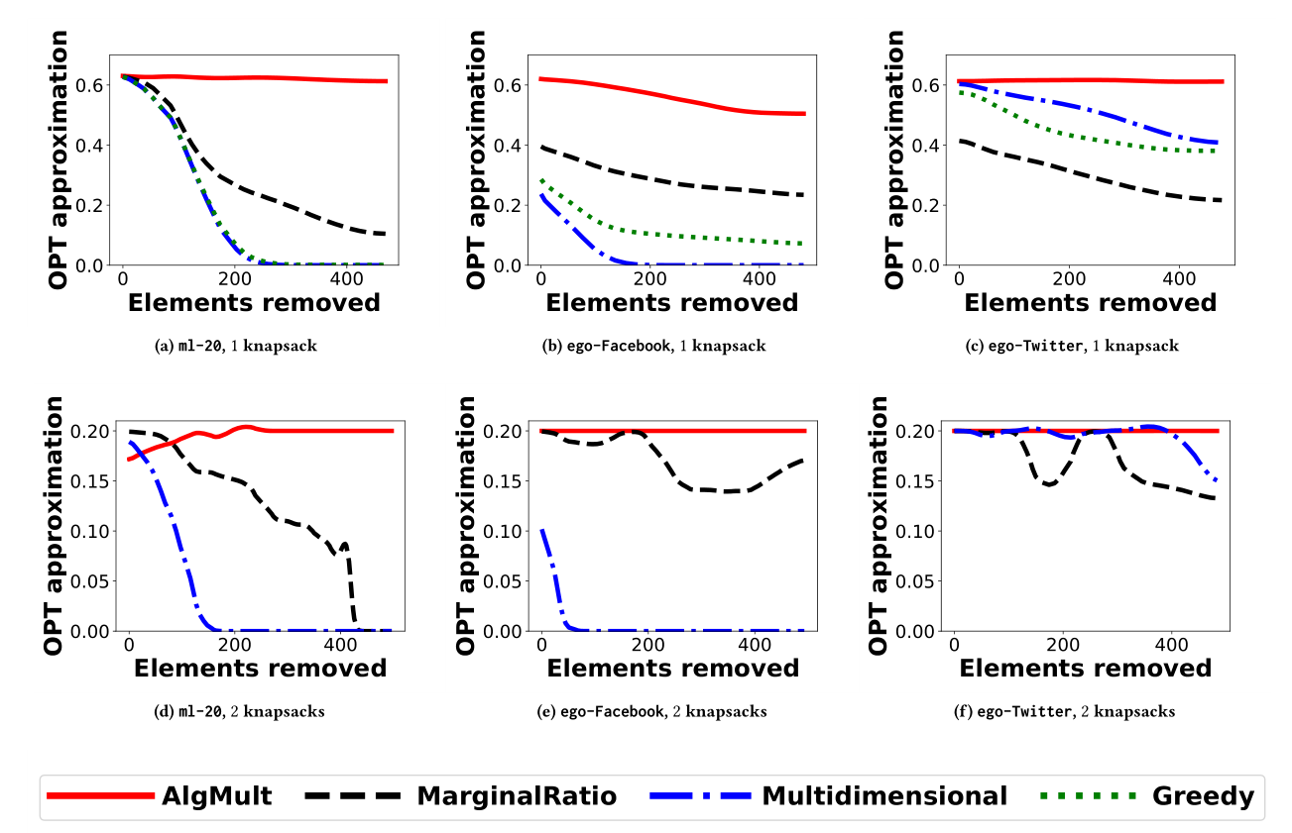
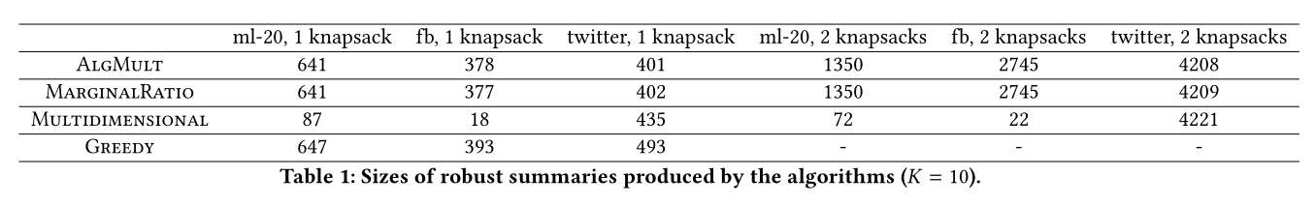
Empirical Evaluations
Baselines: Offline Greedy, “Robustified” versions of streaming algorithms
Social network graphs from Facebook (4K vertices, 81K edges) and Twitter (88K vertices, 1.8M edges) collected by the Stanford Network Analysis Project (SNAP).
Dominating set
MovieLens (27K movies, 200K ratings)
Coverage

Slide 12

Paper: https://arxiv.org/abs/1905.02367
Code: https://github.com/KDD2019SubmodularKnapsack/KDD2019SubmodularKnapsack

